Slide 1
From He to HOLMES: Decoding The Neural Representation of Coreference

Slide 2
What Is COREFERENCE?

Slide 3
To Sherlock Holmes she is always the women.
He felt no emotion akin to love for Irene Adler.

Slide 4
To Sherlock Holmes she is always the women.
He felt no emotion akin to love for Irene Adler.

Slide 5
To Sherlock Holmes she is always the women.
He felt no emotion akin to love for Irene Adler.

Slide 6

377
72
33
23
10
Holmes
Watson
McCarthy
Clair
Doran
Frequency of Character Names

Slide 7

2706
1366
377
361
328
260
72
33
23
10
Holmes
Watson
McCarthy
Clair
Doran
Frequency of Character References

Slide 8
Experimental Design

Slide 9


To Sherlock Holmes she is always the women.

Slide 10


3 patients
To Sherlock Holmes she is always the women.

Slide 11
3 patients
To Sherlock Holmes she is always the women.
PROPN
PROPN
PRON
NOUN

Slide 12

Features: MEG Channels
Logistic Regression Model
ROC
AUC
401 Time Points
Score
Word Onset
Labels: Semantic Features

Slide 13
Analysis 1: Are Different Types of Nouns Differentiable?

Slide 14
Analysis 1: Are Different Types of Nouns Differentiable?
1) Segmented the story into 5 samples
2) Used Trained 1 v All Logistic Regression Model with part of speech as the classes
3) Used ROC AUC to evaluate decodability
4) Used a permutation-cluster test to establish statistical significance

Slide 15
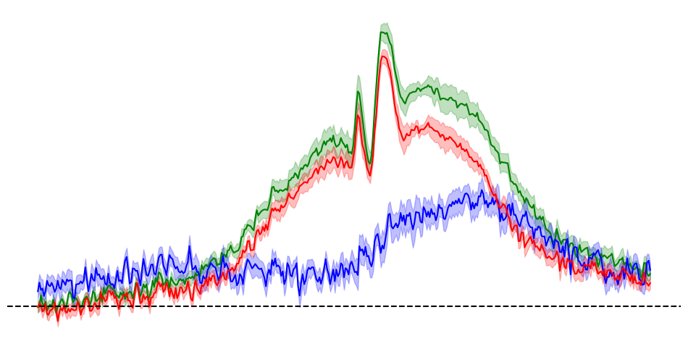
Decoding Performance
over Time (AUC)
0.60
Pronoun
Noun
Proper Noun
0.55
0.50
-2s
0s
2s
Word Onset

Slide 16
Analysis 2:Are there semantically different Neural representations to the same audio stimuli Based on Coreference?

Slide 17
Analysis 2:Are there semantically different Neural representations to the same audio stimuli Based on Coreference?
1) Selected the 18 most common characters in the dataset
2) Selected the 10 most common pronouns associated with these characters
3) For each pronoun, trained a 1 v all LR model for each character with at least 30 coreferences
4) Evaluated using same metrics

Slide 18
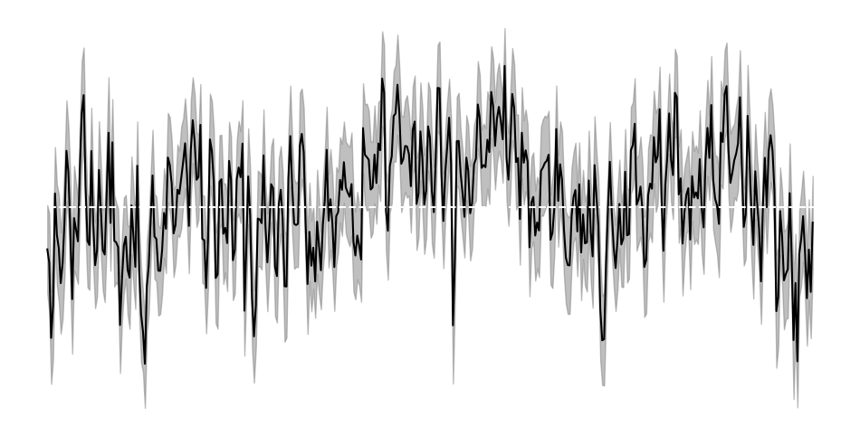
All: Decoding Performance over Time (AUC)
0.52
0.5
0.48
Word Onset

Slide 19
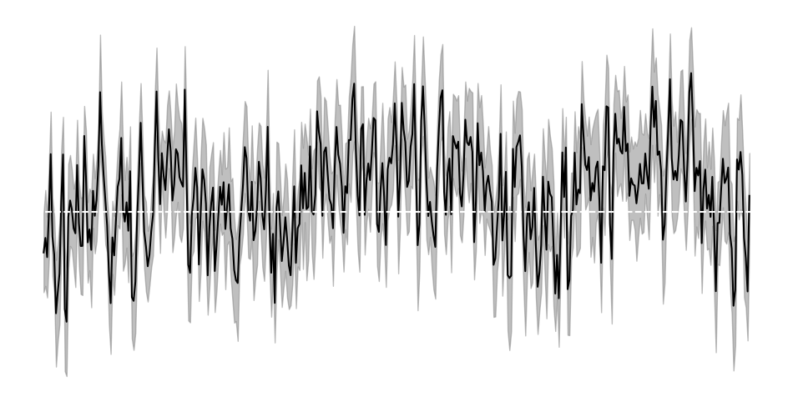
Holmes: Decoding Performance over Time (AUC)
0.54
0.5
0.46
Word Onset

Slide 20
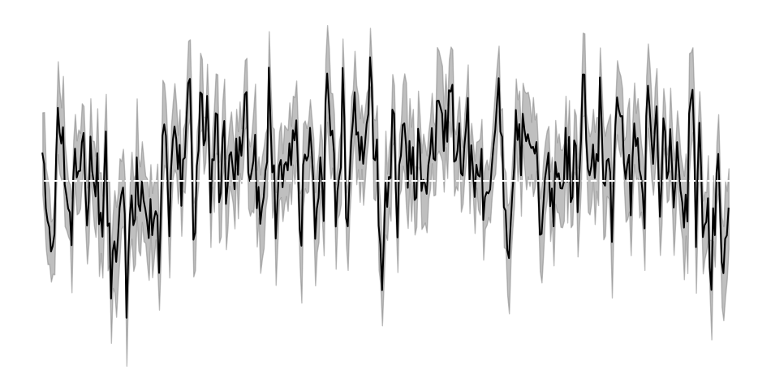
Pronoun (He): Decoding Performance over Time (AUC)
0.56
0.5
0.44
Word Onset

Slide 21
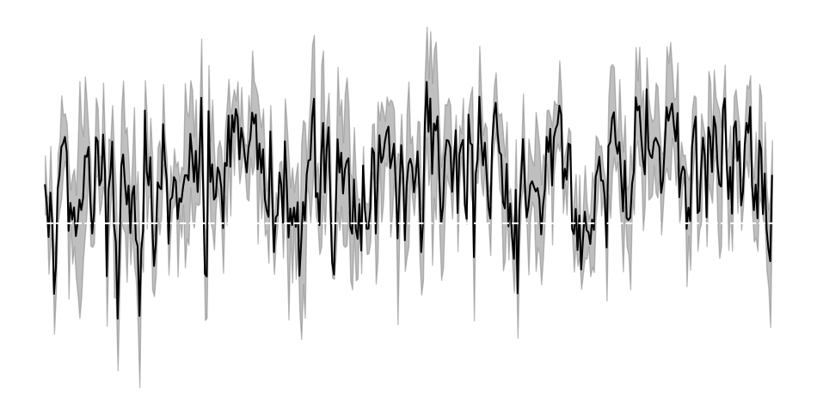
Holmes (He): Decoding Performance over Time (AUC)
0.58
0.5
0.42
Word Onset

Slide 22
Analysis 3:Is there a semantic trace of the Character being replaced by the PRONOUN?

Slide 23
Analysis 3:Is there a semantic trace of the Character being replaced by the PRONOUN?
1) Of the previous 18, chose characters with 2 syllables leaving 18
2) Train a LR classifying characters on associated audio stimuli
3) Test on the referential nouns associated with that character
4) Apply same statistical tests

Slide 24
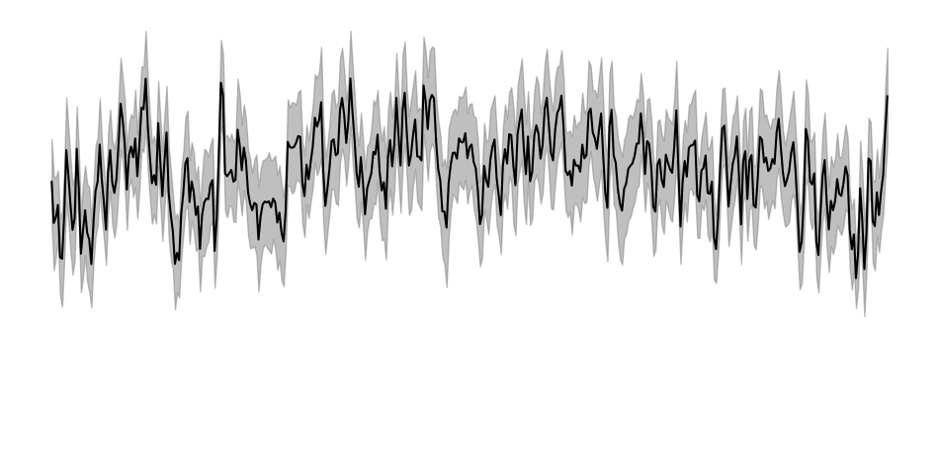
All: Decoding Performance over Time (AUC)
0.54
0.52
0.5
Word Onset

Slide 25
Discussion

Slide 26
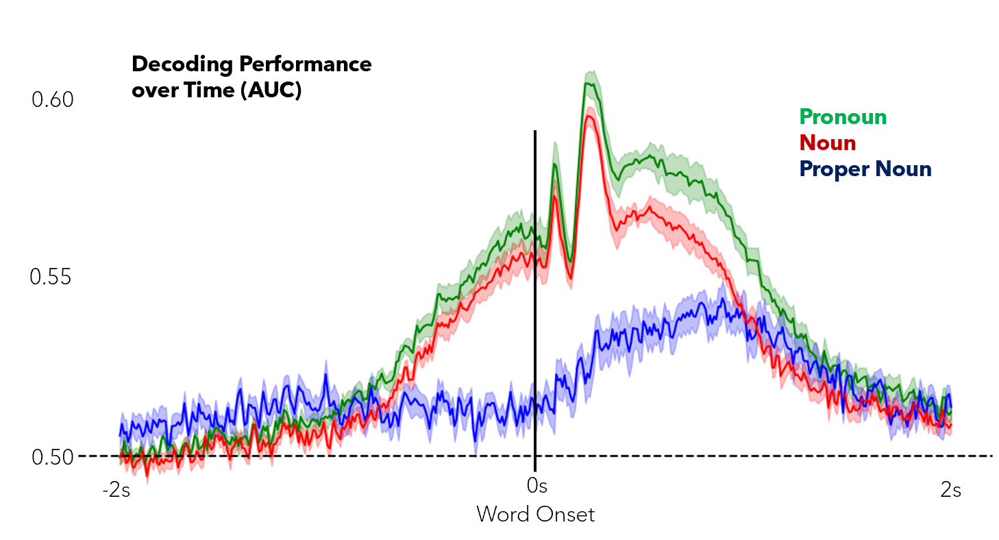
Analysis 1
Clear evidence of different representations between different types of nouns
Show evidence of prediction for common and pronouns as neural activity becomes decodable pre-onset
Trend doesn’t hold w/ proper nouns

Slide 27
Analysis 2 & 3
Didn’t find evidence of a neural trace of coreference during the processing of pronouns
Sources of error in assigning coreference – fastcoref model has an F1 score of 78.5 so the data labeling isn’t perfect
Differences in audio stimuli, particularly with experiment 3 add further levels of noise making it challenging to decipher results.
Despite the dataset being large, certain subtabs of the data are relatively small
Especially characters besides Holmes and Watson

Slide 28
Thank you
Any Questions?

